Slide 1

IT4103 – Web Programming
www.hndit.com
Week 4 ,5 & 6- Client Side Scripting - JavaScript

Slide 2
Learning Outcomes
www.hndit.com
At the end of the lesson student must be able to use dynamic HTML controls and client side Scripting in a web page

Slide 3
Static vs. Dynamic Content
www.hndit.com
Static web pages do not change the content or layout depending on user input.
In contrast, dynamic web pages adapt their content depending on user input or computing environment (user, time or data).
•Dynamic content can be delivered as a result of two technologies:
  Client-side scripting languages
  Server-side scripting languages

Slide 4
Characteristics of Client-side
Scripting
www.hndit.com
Client-side scripts can modify the pages at runtime, and therefore, they also falls under the heading of DHTML (dynamic HTML).
Client-side scripts have greater access to the information and functions available on the user's computer, whereas for server-side scripts its for the server.
Client-side scripts require that the user's web browser understand the scripting language in which they are written.

Slide 5
Some Uses of Client-side Scripting
www.hndit.com
Form verification
  Client-side scripts can parse form data prior to the data being submitted to a handler on the server, ensuring that there are no obvious errors (missing or improperly formatted data).
Document animation and automation
  Accessing element data and properties via the DOM, client-side scripts can affect changes in elements’ content, appearance, size, position, and so forth.
Basic document intelligence
  Client-side scripts can embed a base level of intelligence to the document by linking elements to scripts via events (mouse clicks, key presses, and so on).
Notes:
Document object model

Slide 6
Client-side Scripting Languages
www.hndit.com
JavaScript
JScript
VBScript
ActionScript
AJAX

Slide 7
JavaScript
www.hndit.com
JavaScript was created in 1996 by the Netscape team and released with Netscape 2.0.
The parsing of a document is available through Document Object Model (DOM), a method to access document links, anchors, forms and form objects, and other objects.

Slide 8
Browser Compatibility
www.hndit.com
When creating a web page, it is required to account for the possibility that viewers will be using browsers of various versions from various vendors, for instance,
  Navigator 2, 3, 4, 6 and above
  Internet Explorer 3, 4, 5, 5.5, 6 and above
  Opera 3, 4, 5 and above
  Platforms, such as, Windows 98, Windows NT, the Macintosh, RedHat Linux and SunOS5
Typically JavaScript is used to handle complex browser
incompatibilities with subtle differences in rendering code

Slide 9
Incorporating JavaScript into a
Document
www.hndit.com
There are two main methods for inserting scripts into a HTML document:
  Enclosing the script within script (<script>) tags
    <script language="JavaScript" type="text/JavaScript">
    //Script code here
    </script>
  Use an external script file
    <script language="JavaScript" src="simple.js"
    type="text/javascript"></script>

Slide 10
Some Notes on JavaScript
Incorporation
www.hndit.com
Usually the script tag is placed within the <head> section.
  –The browser which interprets the document executes the <head> section before displaying the <body> section. Therefore, it ensure that the script is loaded before anyone uses it.
Practically the script tag can be placed anywhere within the document
  By placing the script tag within the <body> section, the script can write directly to the web page.

Slide 11
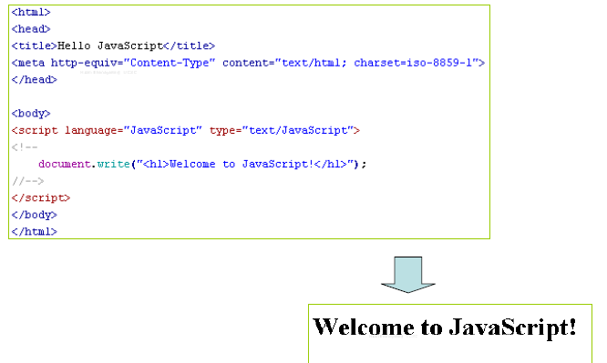
Example
www.hndit.com

Slide 12
Basic JavaScript Syntax
www.hndit.com
All code should appear within appropriate constructs, namely between <script> tags or within event attributes.
With few exceptions, code lines should end with a semicolon (;). Notable exceptions to this rule are lines that end in a block delimiter ({ or }).
Blocks of code (usually under control structures such as functions, if statements, and so on) are enclosed in braces ({ and }).
Although it is not absolutely necessary, explicit declaration of all variables is a good idea.
The use of functions to delimit code fragments is recommended; it increases the ability to execute those fragments independently from one another and encourages reuse of code.
• Comments can be inserted in JavaScript code by prefixing the comment with a double-slash (/ /) for single line or surrounding the comment with / * and * / pairs for multiline.

Slide 13
Data Types and Variables
www.hndit.com
JavaScript is a loosely typed language
  It is not needed to specify the data type of a variable when you declare it, and data types are converted automatically as needed during script execution.
Declaring a variable
  Explicitly declare using the var statement
E.g. var a;
var x = 20, name = “ATIKU”;
  Implicit declaration without using var statement
E.g. x = 20, name = “ATIKU”;

Slide 14
Data Types and Variables
www.hndit.com
JavaScript variables are case sensitive
  E.g. name = “Nimal”;
  Name = “Saman”;
  // two different variables
JavaScript variables have global scope unless they are declared within a function to have local scope.

Slide 15
Data Types and Variables
www.hndit.com
JavaScript supports the following data types:
  Integers: decimal, hexadecimal or octal
    E.g. x = 23; // decimal
    y = 04; // octal
    z = 0xAF; // hexadecimal
  Floating-point numbers
    E.g. x = 2.314; y = 3.4e-2;
  Booleans: true or false
    E.g. x = true; y = 10 < 9;

Slide 16
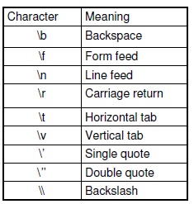
Data Types and Variables
www.hndit.com
Strings
E.g
x = “This is a message”;
y = “The answer is \n 34”;
Special characters
(see the table)

Slide 17
Data Types and Variables
www.hndit.com
Arrays
E.g.
Months = new Array(“Jan”, “Feb”, “Mar”, “Apr”);
Days = new Array(2);
Days[0]=12; Days[1]=23;
Objects
E.g. today = new Date;

Slide 18
Expressions
www.hndit.com
An expression is any valid set of literals, variables, operators, and expressions that evaluates to a single value.
The value may be a number, a string, or a logical value.
There are two types of expressions:
  those that assign a value to a variable
    E.g. x = 3;
  those that simply have a value
    E.g. 3 + 8;

Slide 19
Operators
www.hndit.com
JavaScript supports the standard operators for numbers and strings. The following is an outline of JavaScript operators:
  Assignment operators
  Arithmetic operators
  Comparison operators
  Logical operators
  Bitwise operators
  String operators

Slide 20
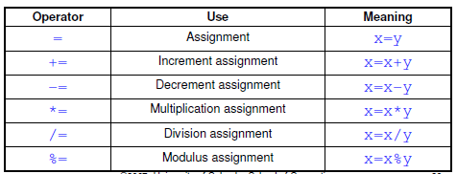
Assignment Operators
www.hndit.com
An assignment operator assigns a value to its left operand based on the value of its right operand.
E.g. x = 23;

Slide 21
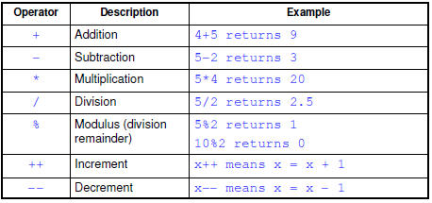
Arithmetic Operators
www.hndit.com
Arithmetic operators take numerical values (either literals or variables) as their operands and return a single numerical value.

Slide 22
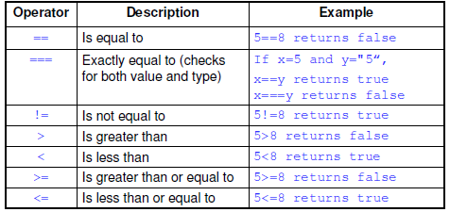
Comparison Operators
www.hndit.com
A comparison operator compares its operands and returns a logical value based on whether the comparison is true or not.

Slide 23
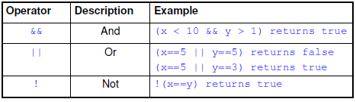
Logical operators
www.hndit.com
Logical operators return a Boolean value.
Let x = 6 and y = 3,

Slide 24
Bitwise Operators
www.hndit.com
Bitwise operators treat their operands as a set of bits (zeros and ones), rather than as decimal, hexadecimal, or octal numbers.

Slide 25
String Operators
www.hndit.com
In addition to the comparison operators, which may be used on string values, the concatenation operator (+) concatenates two string values together, returning another string that is the union of the two operand strings.
E.g. “Today is a” + “ nice day” return “Today is a nice day”
The shorthand assignment operator += can also be used to concatenate strings.
E.g message = “Click”;
  message+=“ A”; message+=“ B”;
  now message is “Click A B”

Slide 26
Control Structures
www.hndit.com
JavaScript supports the following control structures,
  Do…While
  While
  For and For…In
  If…Else
  Switch
  Break and Continue
  Labels

Slide 27
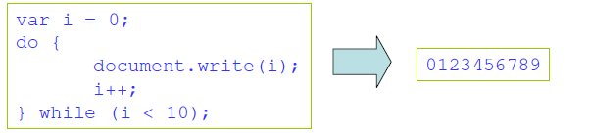
Do…While
www.hndit.com
The do…while loop executes one or more lines of code as long as a specified condition remains true.
E.g.
Note: Due to the expression being evaluated at the end of the structure, statement(s) in the do…while loop are executed at least once, even if the condition is false.

Slide 28
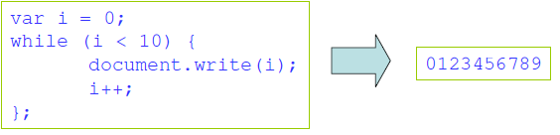
While
www.hndit.com
The while loop executes one or more lines of code while specified expression remains true.
E.g.
Note: Because the expression is evaluated at the beginning of the loop, the statement(s) will not be executed if the expression is false at the beginning.

Slide 29

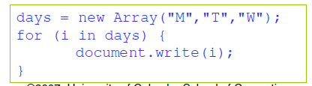
For and For…In
www.hndit.com
The for loop executes statement(s) a specified number of times governed by two expressions and a condition.
E.g.
The for...in loop executes statement(s) while assigning a variable to the properties of an object or elements of an array.
E.g.

Slide 30
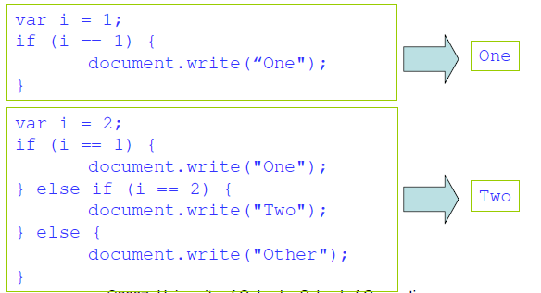
If…Else
www.hndit.com
The if and if…else constructs execute a block of code depending on the evaluation (true or false) of an expression.
E.g.

Slide 31
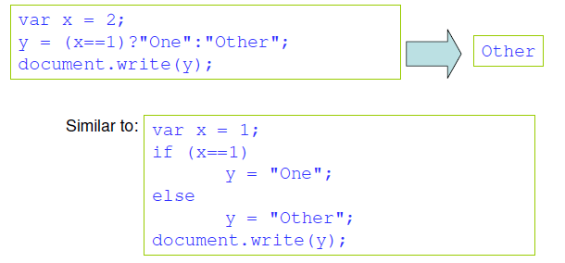
Conditional Operator
www.hndit.com
JavaScript also contains a conditional operator that assigns a value to a variable based on some condition.
E.g.

Slide 32
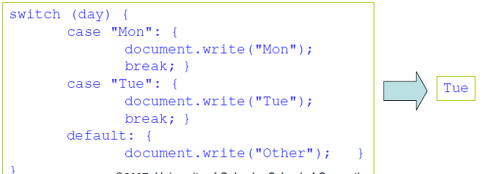
Switch
www.hndit.com
The switch construct executes specific block(s) of code based on the value of a particular expression.
  Note: Use break statement to prevent the code from running into the next case automatically.
E.g.

Slide 33
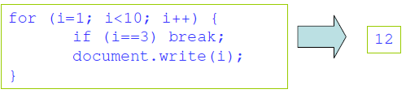
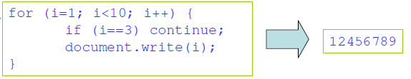
Break and Continue
www.hndit.com
The break command will break the loop and continue executing the code that follows after the loop (if any).
E.g.
The continue command will break the current loop and continue with the next value.
E.g

Slide 34
Labels
www.hndit.com
Labels are used to mark statements for reference by other statements in other sections of a script.
Labels can solve the problem of breaking from a loop that is nested inside another loop.
E.g.

Slide 35
Functions and Procedures
www.hndit.com
A function in a JavaScript is a set of statements that performs a specific task (a procedure).
A function will be executed by an event or by a call to that function.
Functions can be defined both in the <head> and in the <body> section of a document. However, to assure that the function is read/loaded by the browser before it is called, it could be wise to put it in the <head> section.
A function can be called from anywhere within the page (or even from other pages if the function is embedded in an external .js file).

Slide 36
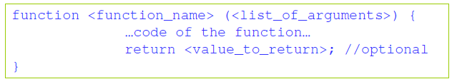
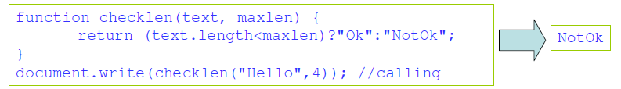
Defining and Calling a Function
www.hndit.com
A user-defined function has the following syntax:
When calling a function, the argument list should be supplied correctly (should match with the definition):

Slide 37
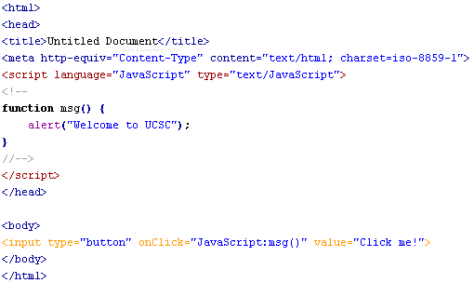
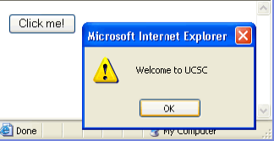
Example
www.hndit.com

Slide 38
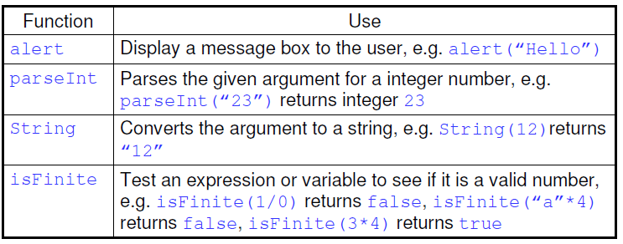
Built-in Functions
www.hndit.com
JavaScript provides few built-in functions for data manipulation. The following table gives some of them:

Slide 39
JavaScript Objects
www.hndit.com
JavaScript is an object-driven language (not fully object oriented, such as Java).
JavaScript has several built-in objects.
  E.g. two specific objects exists for manipulate data: one for performing math operations (Math) on numeric data and another for performing operations on string values (String)
An object is a collection of properties and methods (functions).
  Properties are values associated with an object
  Methods are the actions that can be performed on objects

Slide 40
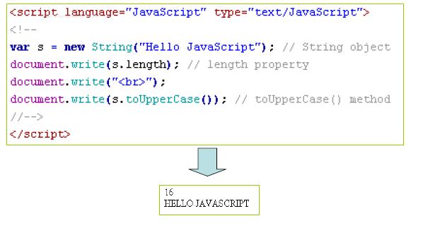
Example
www.hndit.com

Slide 41
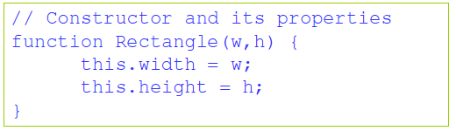
User-Defined Objects
www.hndit.com
Creation of new, custom objects requires the existence of an object constructor.
The keyword this refers to the current object that called the constructor function.
E.g. the following function can be used to construct totally new objects of a Rectangle class

Slide 42

Example
<html>
<head>
<script language="JavaScript" type="text/JavaScript">
function Rect_Area() {
return this.width*this.height; }
function Rect_Perimeter() {
return 2*(this.width+this.height); }
function Rectangle(w,h)
{
this.width=w;
this.height=h;
this.area=Rect_Area;
this.perimeter=Rect_Perimeter;
}
rect=new Rectangle(4,3);
document.write(rect.width);
document.write("<br>");
document.write(rect.area());
</script>
</head>
<body>
</body>
</html>
www.hndit.com

Slide 43
Document Object Model
www.hndit.com
The DOM is a type of application program interface (API) allowing programming language access to the structure of a web document.
The HTML DOM is a W3C standard.
  However, Netscape and Microsoft IE have their own proprietary DOM specifications in addition to W3C DOM.
Using the DOM interface, all HTML elements, along with their containing text and attributes, can be accessed for modification, deletion or to add new elements.
The HTML DOM is platform and language independent.
  It can be used by any programming language like Java, JavaScript, and VBScript.

Slide 44
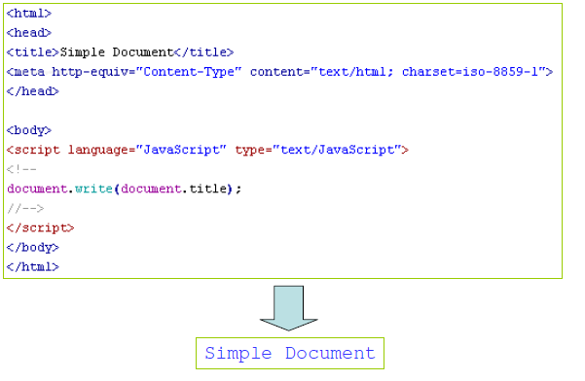
Example – Retrieving the Title
www.hndit.com

Slide 45
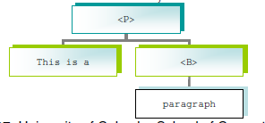
DOM Nodes
www.hndit.com
The latest DOM specification (Level 1) is supported by Mozilla and Microsoft IE 5 onwards.
According to Level 1 DOM, each object, whatever it may be exactly, is a Node.
  E.g. 1. <P>This is a paragraph</P> will create two nodes: an element P and a text node with content 'This is a paragraph'
  E.g. 2. In <P>This is a <B>paragraph</B></P> the element node P has two children, one of which has a child of its own

Slide 46
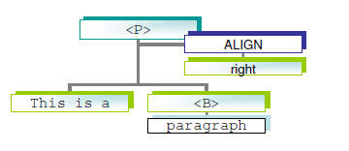
DOM Nodes
www.hndit.com
E.g. 3. In <P ALIGN="right">This is a <B>paragraph</B></P> the element node P has an attribute node of ALIGN="right”
The element node P also has its own parent, this is usually the document

Slide 47
Netscape DOM
www.hndit.com
Window
Frame
Document
Location
History
Layer
Link
Image
Area
Anchor
Applet
Plugin
Form
Textures
Text
FileUpload
Password
Hidden
Submit
Reset
Radio
Checkbox
Button
Select
option
Navigate
Plugin
Mime Type

Slide 48
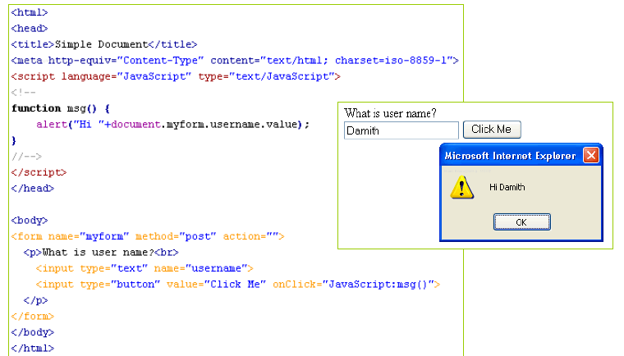
Traversing the DOM
www.hndit.com

Slide 49
Some Important Objects
www.hndit.com
Object | Description
Window | The top level object in the JavaScript hierarchy. The Window object represents a browser window. A Window object is created automatically with every instance of a <body> or <frameset> tag
Navigator | Contains information about the client's browser
Screen | Contains information about the client's display screen
History | Contains the visited URLs in the browser window
Location | Contains information about the current URL

Slide 50
Event Handling
www.hndit.com
Events make a web document interactive by responding to user’s actions.
  E.g. Display a message when you press a button
JavaScript supports various events, such as, onClick , onKeyPress , and so forth
Some examples for events:
  A mouse click
    A web page or an image loading
    Moussing over a hot spot on the web page
    Selecting an input box in an HTML form
    Submitting an HTML form

Slide 51
Example
www.hndit.com
<html><head>
<script language="JavaScript" type="text/JavaScript">
function highlight(obj) {
obj.style.border="solid blue 4px"
obj.style.backgroundColor="yellow"; }
function normal(obj){
obj.style.border="none none none"
obj.style.backgroundColor="white"; }
</script></head><body>
<h1 onMouseOver="style.color='red'" onMouseOut="style.color='black'">HNDIT -ATI Kurunegala </h1>
<p id="p1" onMouseOver="JavaScript:highlight(p1)" onMouseOut="JavaScript:normal(p1)"> Second Year Students</p>
</body></html>

Slide 52
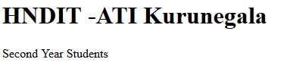

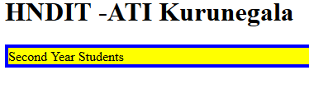
Example
www.hndit.com
Mouse Over Event
Mouse Over Event

Slide 53
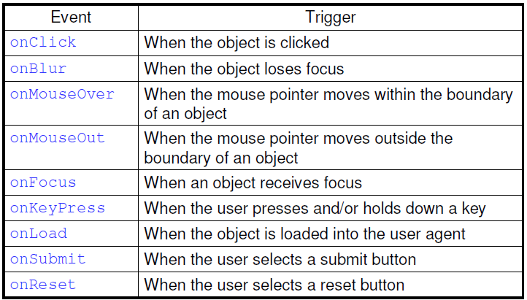
Some JavaScript Events
www.hndit.com

Slide 54
Using JavaScript for Form
Validation
www.hndit.com
JavaScript can be used to validate input data in HTML forms before sending off the content to a server.
Form data that typically are checked by a JavaScript could be:
  has the user left required fields empty?
  has the user entered a valid e-mail address?
  has the user entered a valid date?
  has the user entered text in a numeric field?

Slide 55
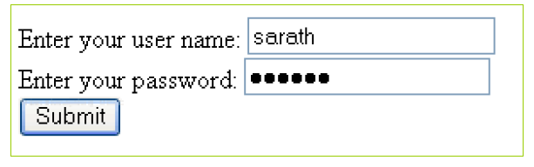
Form Validation Example
www.hndit.com
A form to get user name and password. Validation required to check
  has the user left required fields empty
  has the user entered text in correct length

Slide 56
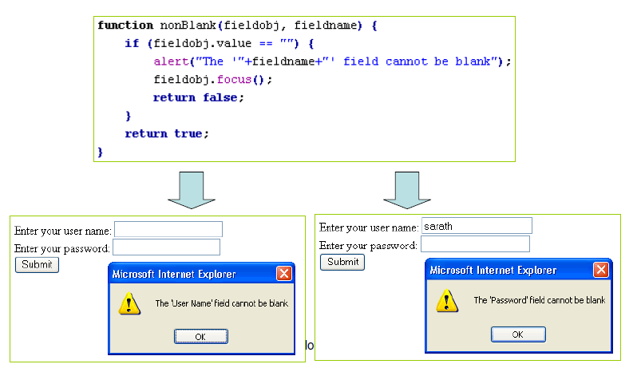
Checking the Field is Not Blank
www.hndit.com

Slide 57
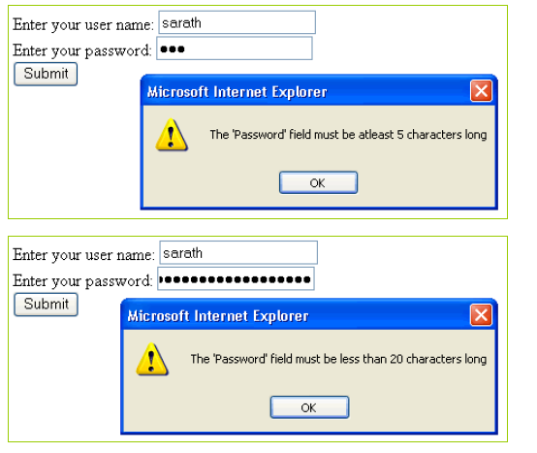
Checking the Field is in Correct
Length
www.hndit.com

Slide 58
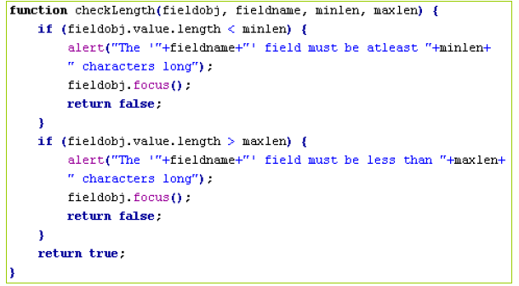
Checking the Field is in Correct
Length
www.hndit.com

Slide 59
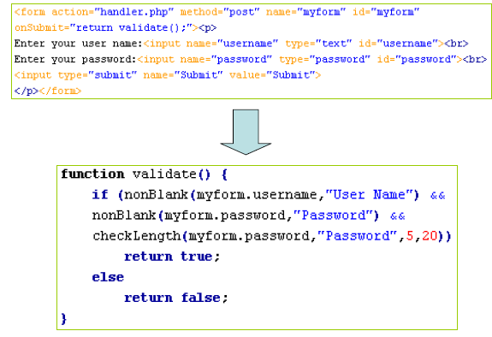
Main Form Handler
www.hndit.com

